Slide 1

Analysis of Medicare Part D: insights on Prescription Drug Coverage
IVIE IRIVBOGBE
BANA 6390 SPRING 2024
03/26/2024

Slide 2
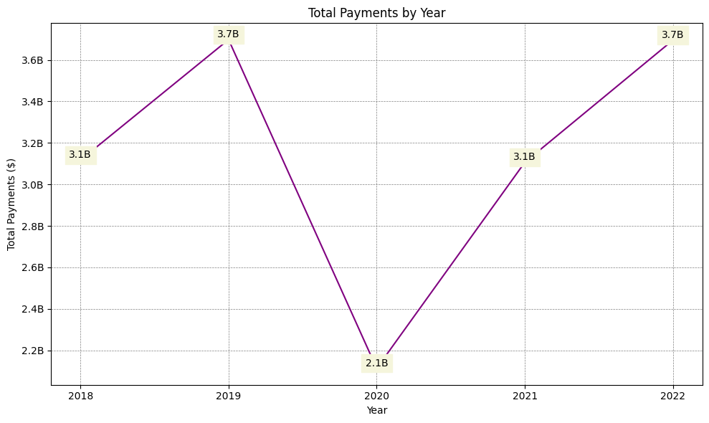
Healthcare Industry Payments Experienced a Significant Decline in 2020 Following a Peak in 2019 but Rebounded to Near-Peak Levels by 2022

Slide 3
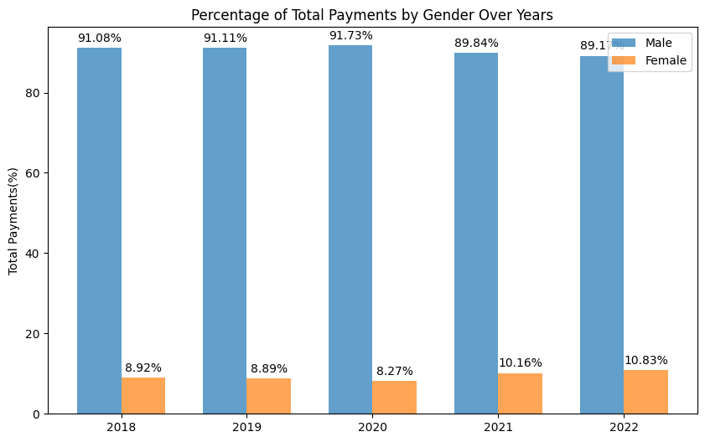
The Data Highlights a Persistent Gender Gap in Payment Distribution Within the Healthcare Sector, with Male Providers Consistently Receiving a Predominant Share

Slide 4
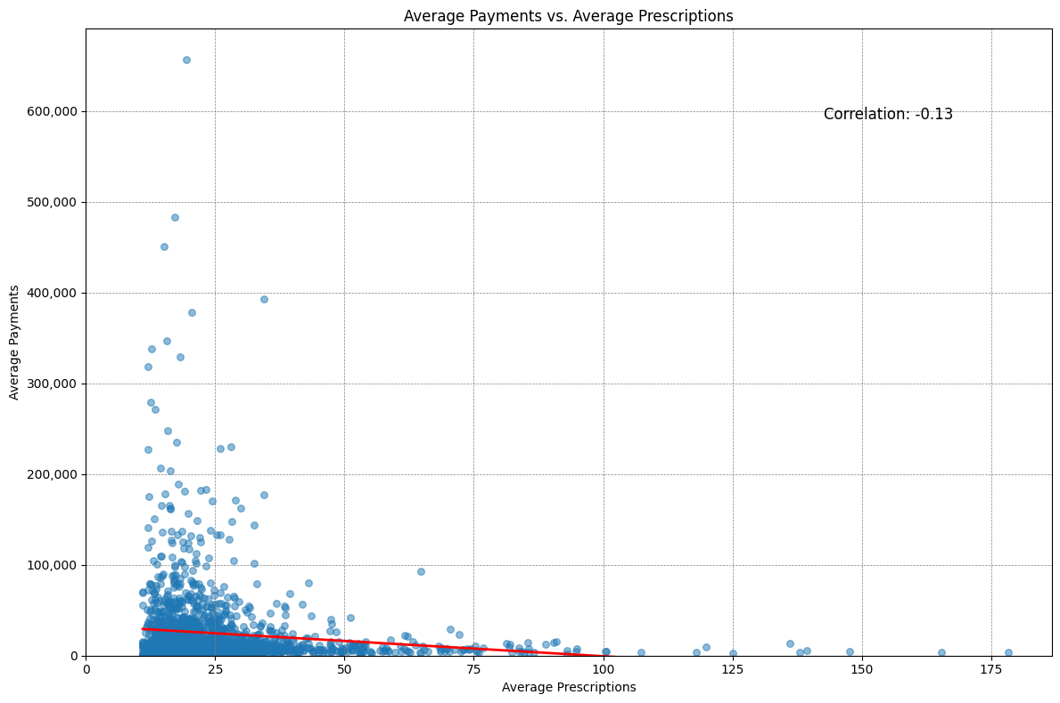
A Weak and Slightly Inverse Relationship Between Average Payments to Healthcare Providers and the Average Number of Prescriptions They Write

Slide 5
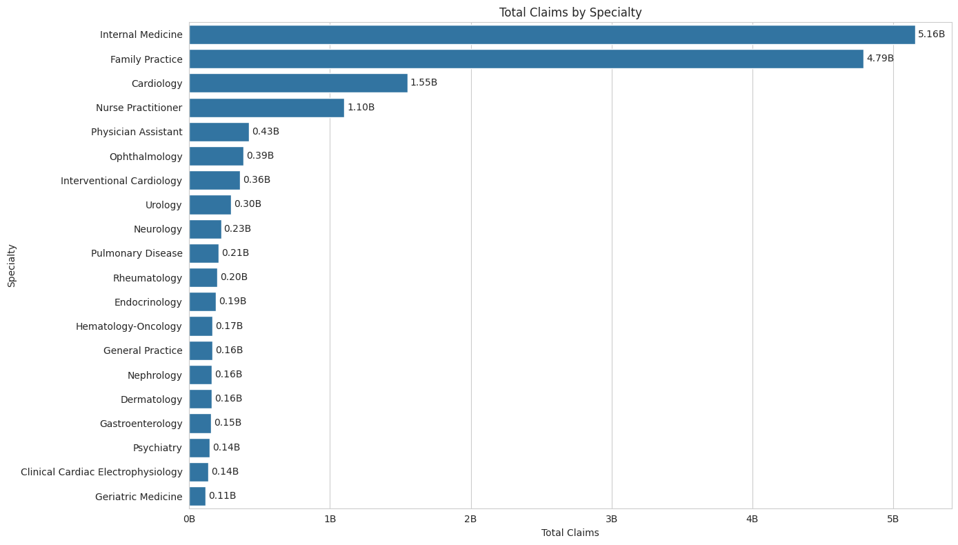
In the Context of Total Claims by Medical Specialty, There Is a Clear Disparity, with Internal Medicine and Family Practice Leading Substantially Over Other Specialties

Slide 6
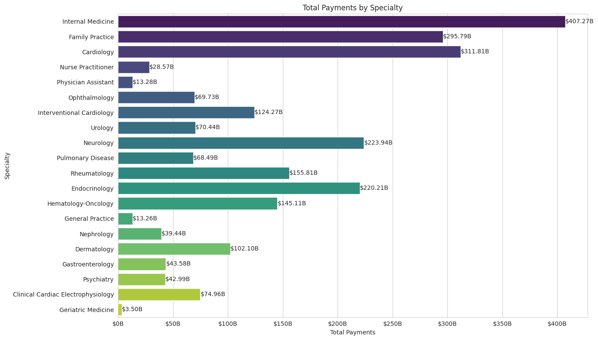
Endocrinology, Neurology, and Cardiology Receive Relatively High Payments, Suggesting These Fields Involve More Complex and Higher-cost Treatments"

Slide 7
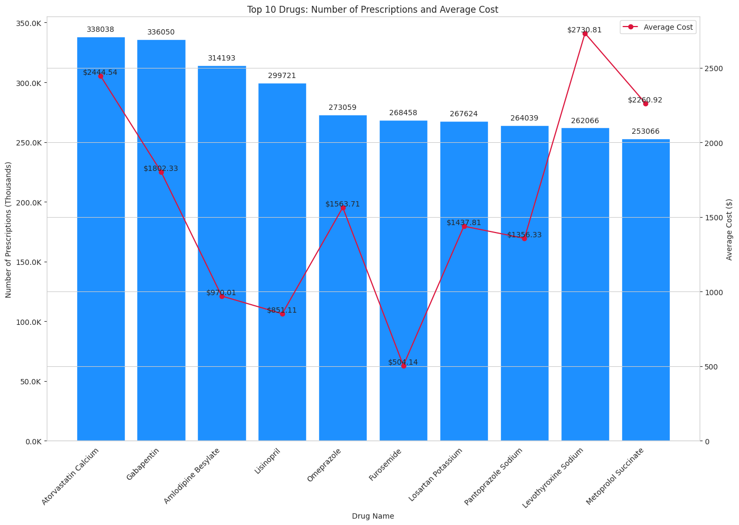
Levothyroxine Sodium, Despite Not Being the Most Frequently Prescribed Drug, Incurs a High Average Cost per Prescription

Slide 8
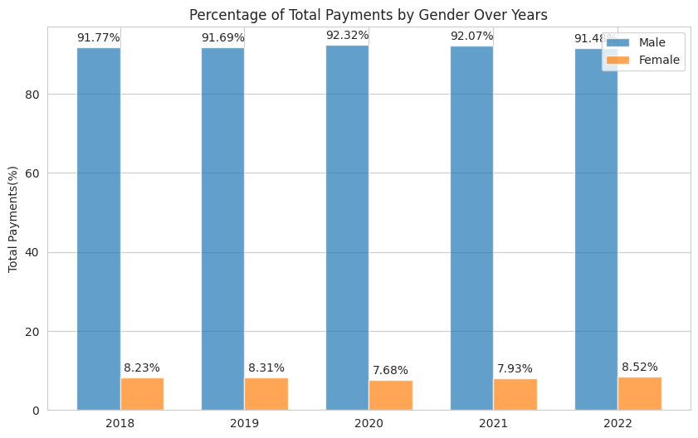
Continued Gender Disparity Gap in the Distribution of Payments Amongst Medical Doctors

Slide 9
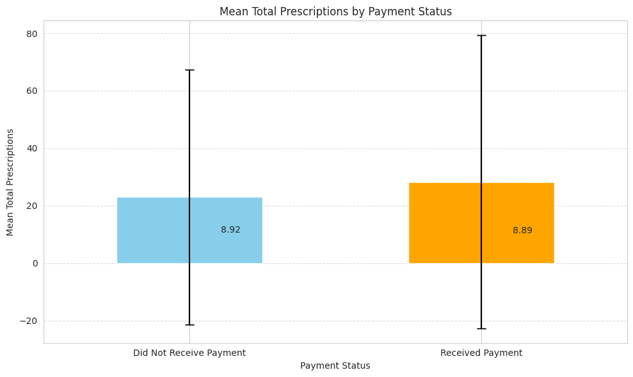
Providers without payment filled more prescriptions on average(Grad year - 2010 and up)

Slide 10
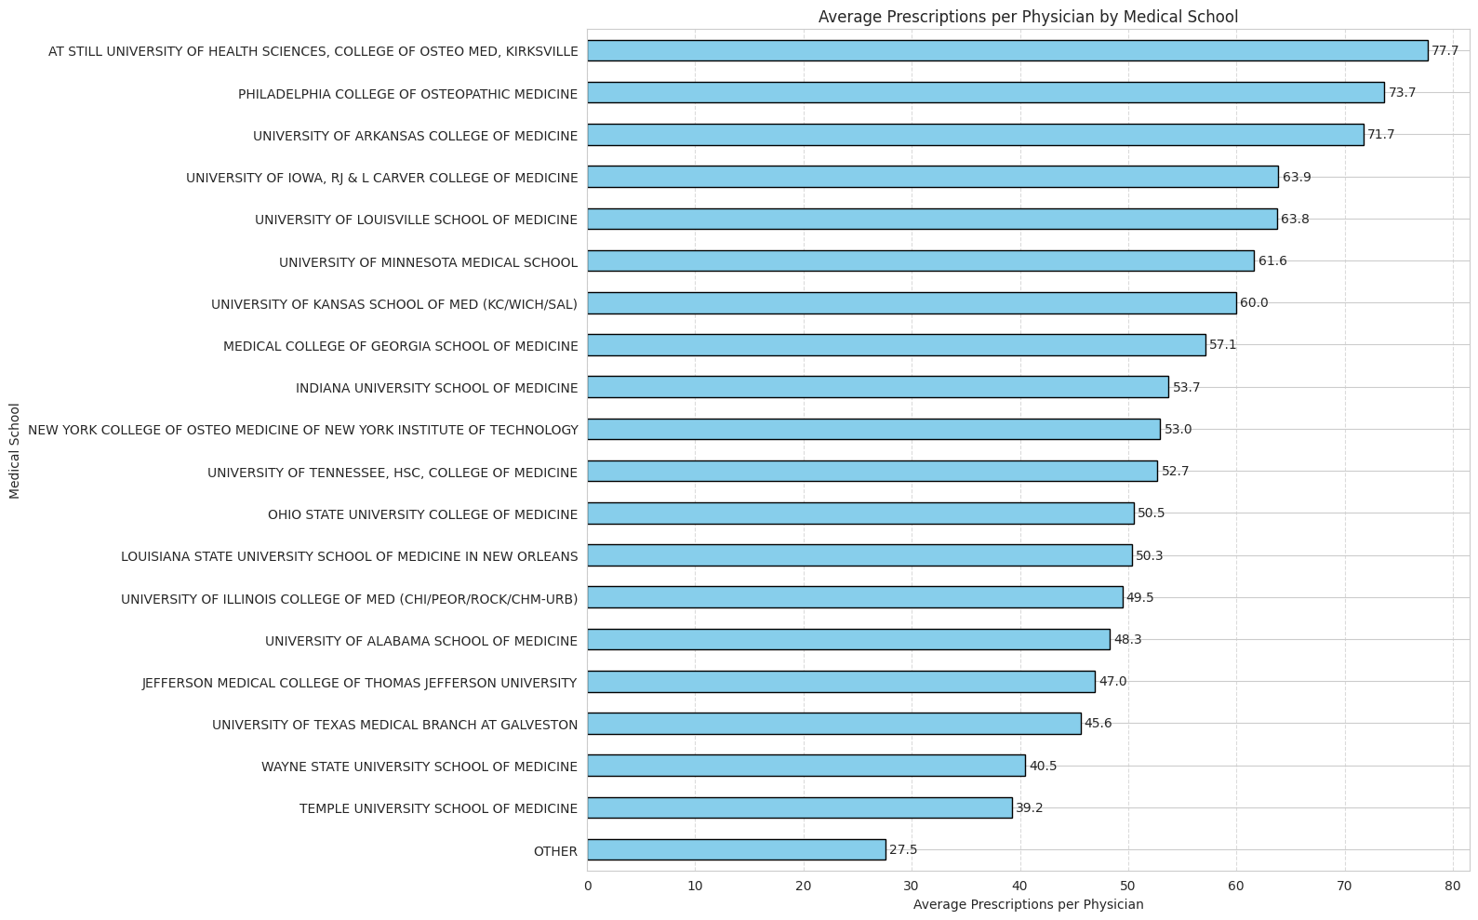
Variations in Prescription Volumes Highlight Differences in Clinical Training at U.S. Medical Schools

Slide 11
THANK YOU!

